Slide 1
Lecture 1 – Introduction to computational biology and R
Adam Sorbie
Institute for Stroke and Dementia Research
Munich, Germany
Gut Brain axis course 29.06.23

Slide 2
Course objectives
Aimed at students in biological/medical sciences (any discipline).
Develop an understanding of what computational biology is and what is required to become a computational biologist.
Practical training:
Introduction to R
RNAseq analysis
16S rRNA sequencing analysis

Slide 3
Day 1 structure
Pre-course poll
Computational Biology
15 min break
Hands-on practical - Introduction to R
15 min break
NGS/RNAseq

Slide 4
Lecture Outline
1.
What is computational biology and why is it important?
2.
What skills does a computational biologist need?
3.
Introduction to the R programming language – theory and concepts
4.
Introduction to RNAseq

Slide 5
What is computational biology?
Computational biology –
analysis of biological data using computational techniques,
Discovery of new biological insights.
Computational biology vs bioinformatics
bioinformatics mostly focused on software and algorithm development
Analysis of complex, high-throughput datasets

Slide 6
Why is computational biology important?
Complex omics datasets are increasingly common in biology
Rare to see papers in top journals without some sort of sequencing/mass spec dataset.
This is likely only to increase further
There is a need for people who can are able to understand and extract insights from these datasets.

Slide 7
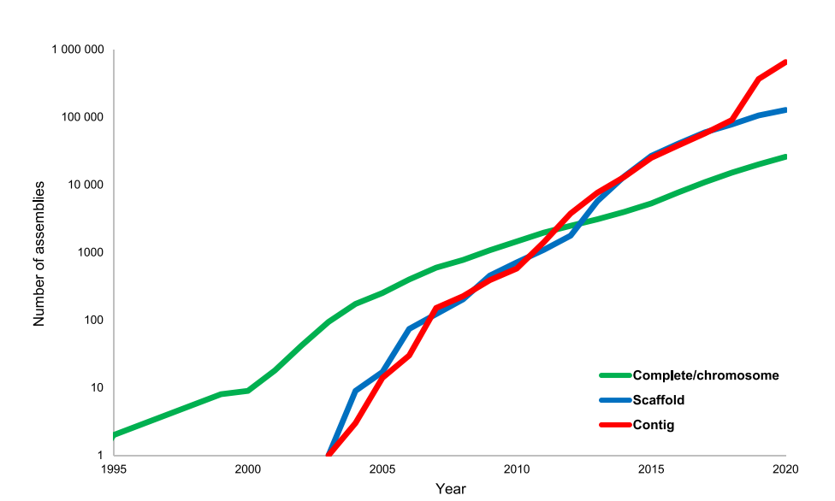
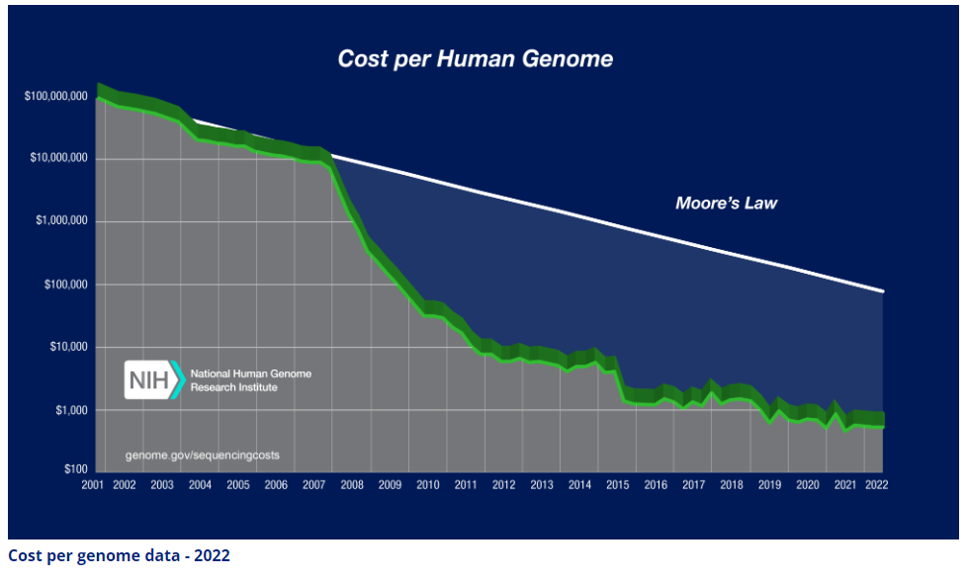
Why is computational biology important cont.
Cost of sequencing has decreased dramatically in the last 15 years.
This has led to a massive increase in the volume of data produced by biological experiments.
Source: https://www.genome.gov/about-genomics/fact-sheets/Sequencing-Human-Genome-cost
Koonin, Makarova and Wolf, Trends in Microbiology, 2021

Slide 8
What skills are required?
Programming/Data wrangling
Required for data processing, analysis and visualisation.
High-performance computing
Some datasets may be too large or use too much resources for a normal laptop/desktop PC.
Statistics
At least understanding of applied statistics
Domain knowledge
Understanding of the underlying biology
Stats
Biostats
Data
science
Bioinformatics
Biology
Comp. sci
Comp. biology

Slide 9
Lecture Outline
1.
What is computational biology and why is it important?
2.
Omics data types
3.
Introduction to the R programming language – theory and concepts
4.
Introduction to RNAseq

Slide 10
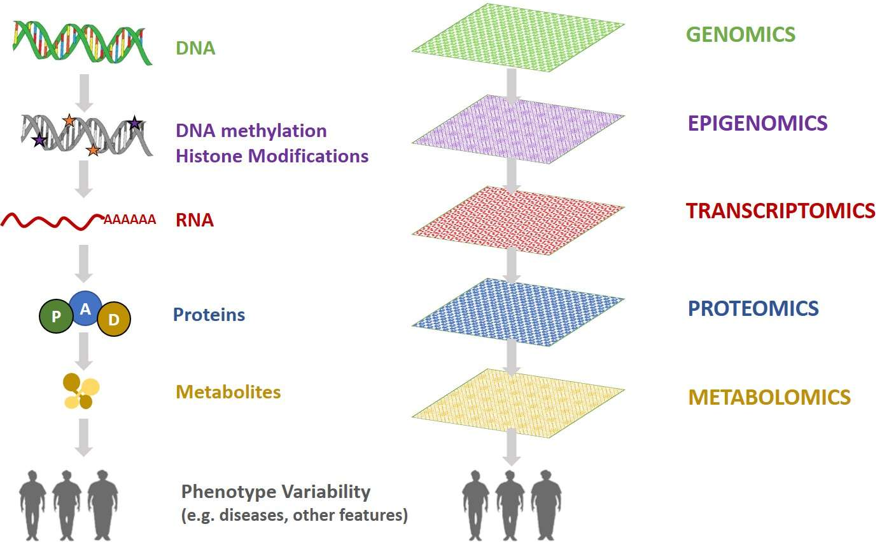
Omics data
Omics
High throughput
Measurement of all or as many as possible molecules of a given biomolecule (e.g., DNA, proteins, metabolites).
Measurements performed using high-throughput instruments
E.g., Sequencers, Mass spec
Generally, yield large, multi-dimensional datasets.
Computational biology
Source: https://comics.dcv.fct.unl.pt/resources/

Slide 11
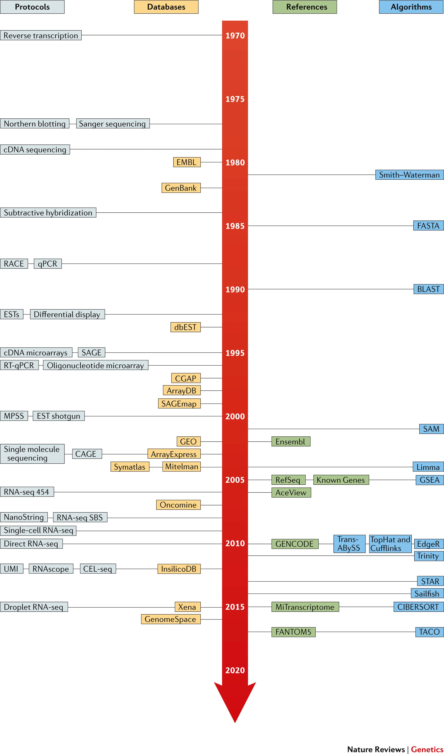
Transcriptomics
Relative quantification of mRNA levels (reverse transcribed into cDNA) in biological samples.
High-throughput sequencing (HTS), RNAseq currently main method but previously microarrays were used.
Single-cell RNAseq also now common, enabling measurement of transcriptome at single-cell level
Cieślik and Chinnaiyan 2017, Nature Reviews Genetics

Slide 12
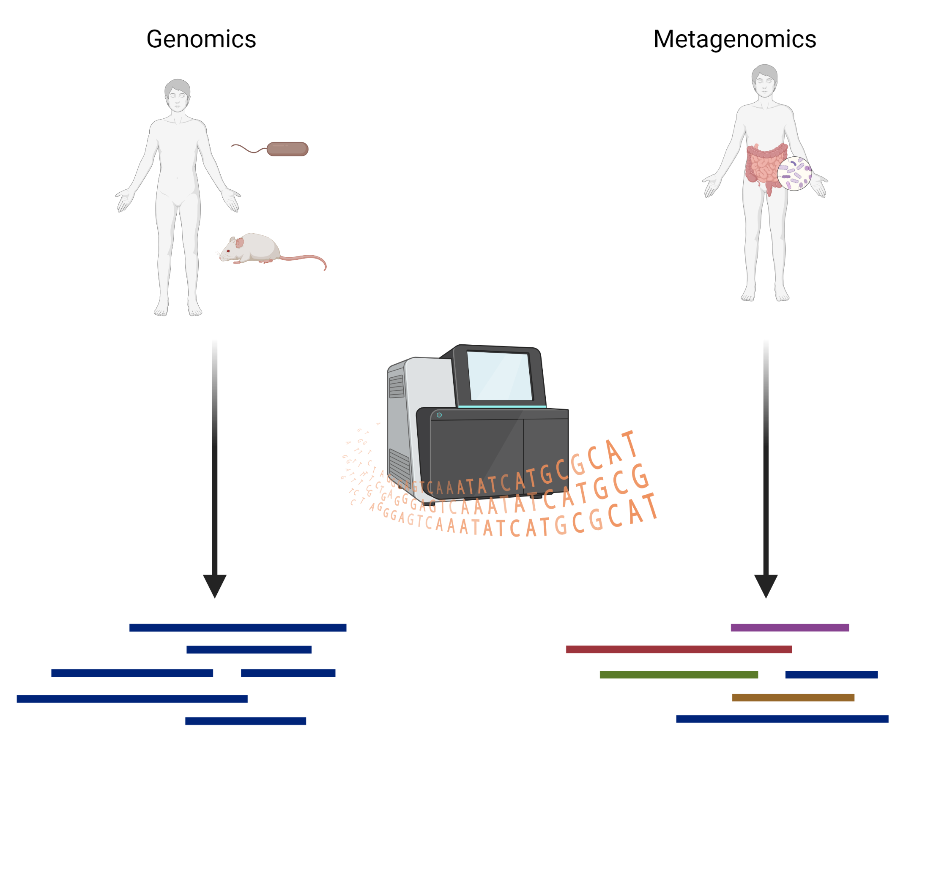
(Meta)genomics
Relative quantification of DNA in a sample
Also uses HTS
Depending on sequencing depth and sample type, enables:
Genomics - Whole genome analysis/SNV calling
Metagenomics - Identification of microorganisms/their functional potential

Slide 13
Lecture Outline
1.
What is computational biology and why is it important?
2.
Omics data types
3.
Introduction to the R programming language – theory and concepts
4.
Introduction to RNAseq

Slide 14


The R programming language
Free open-source language, first released in 1993.
Designed for statistical analysis and visualisation of data.
IDE Rstudio provides an easy interface to interact with R
Advantages | Disadvantages
Comprehensive ecosystem | Can be difficult to learn
Many, well-maintained and well documented libraries | Choosing between base R vs tidyverse can be difficult for beginners.
R is a high-level language, which can be run in real time and does not require compilation | Relatively slow in comparison to other languages

Slide 15
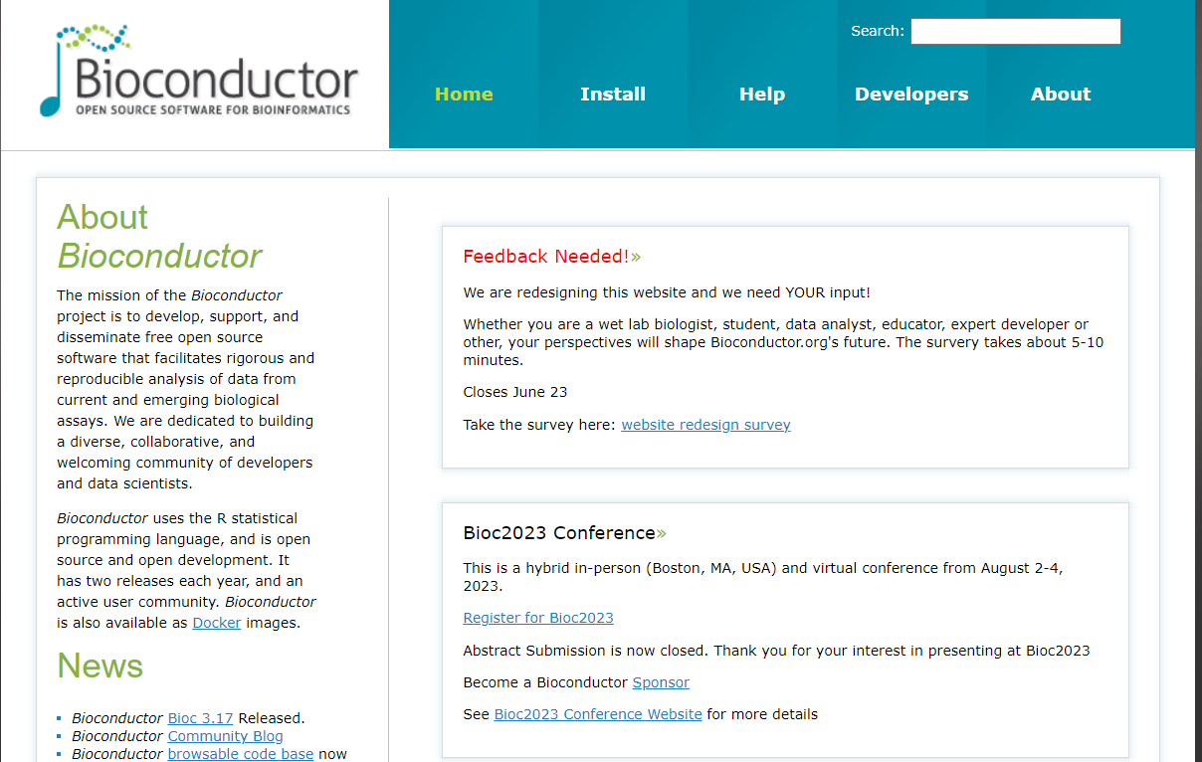
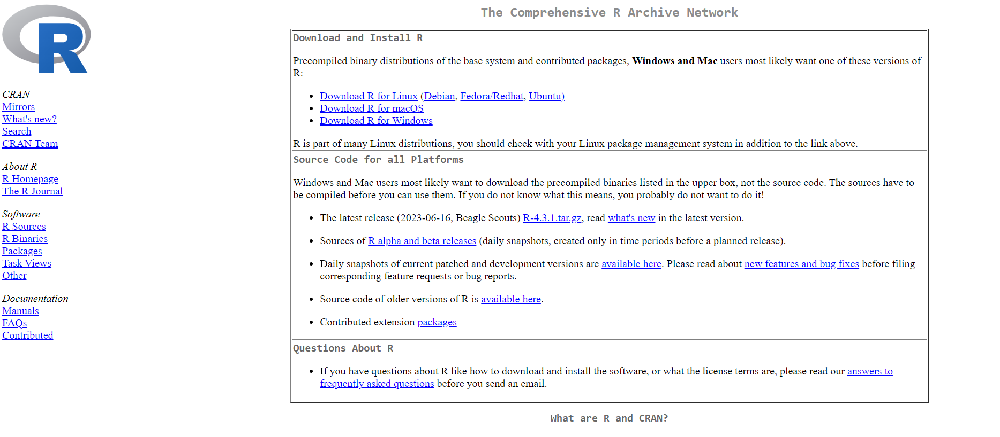
R for computational biology
R packages for computational biology, generally installed from two main sources: CRAN or BioConductor.
CRAN is mostly statistical/general purpose packages
BioConductor comprises packages specifically designed for analysis of biological data.
Enables access to methods/algorithms to facilitate analysis
Both repositories (but particularly BioConductor) include extensive documentation and tutorials
Code is written in R scripts or using code notebooks (Rmarkdown/Quarto).
Writing code in notebooks is great for reproducibility.

Slide 16
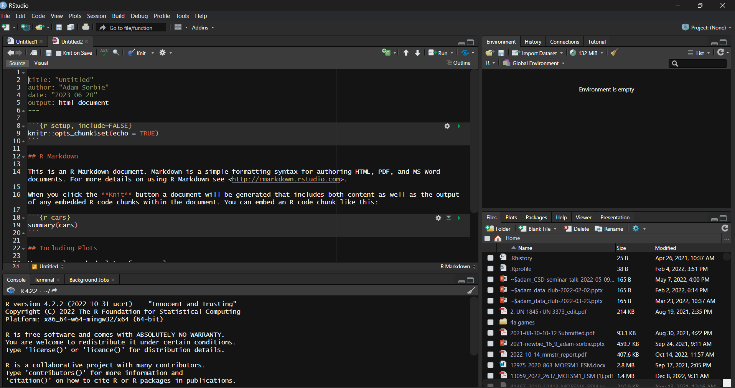
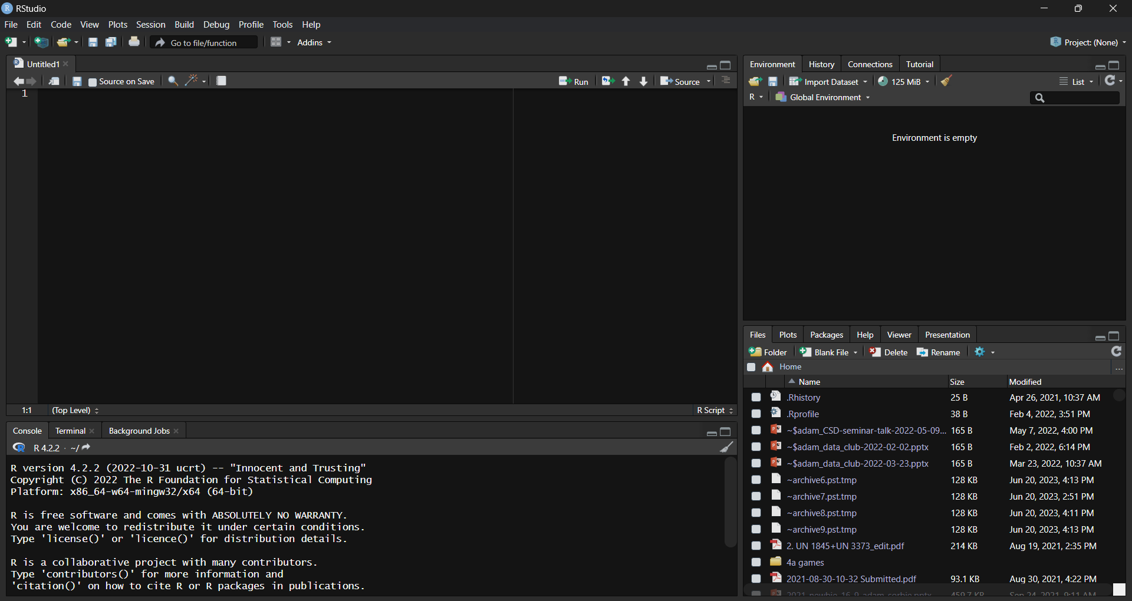
Working with R/Rstudio
Script editor – where you write scripts
Console – run code interactively
Environment – things you create/source stored here.
In an Rmarkdown notebook the script editor is replaced with a notebook allowing you to intersperse text with code blocks.
Script editor
Environment
Notebook
Script editor
File system/help/packages
Console

Slide 17
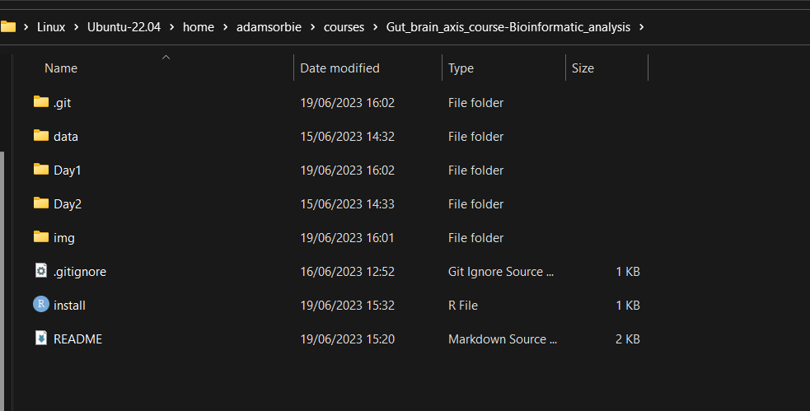
Working with R/Rstudio – working directory
Working directory is a crucial concept to understand
Where R is looking for/outputting files
Check current working directory with get_wd() or set with set_wd()
E.g. set_wd(“C:/Users/adam-/Gut_brain_axis_course-Bioinformatic_analysis”)
Important to understand the difference between relative and absolute paths.
Using above as example
Relative – “Day1”
Absolute – “C:/Users/adam-/Gut_brain_axis_course-Bioinformatic_analysis/Day1”

Slide 18
Working with R/Rstudio – writing and running code
You can write code in the console or script editor/notebook in case of Rmarkdown.
Always better to write a script/notebook as the code is recorded – reproducible.
To run a command press ctrl + Enter (cmd + Return on Macs)
In an Rmarkdown notebook, code can also be ran by pressing the green play button
Rmarkdown
Typing outside of a code block is interpreted as markdown text
To insert a new code block press ctrl + alt + I (again replace ctrl with cmd on Macs)

Slide 19
Lecture Outline
1.
What is computational biology and why is it important?
2.
Omics data types
3.
Introduction to the R programming language – theory and concepts
4.
Introduction to RNAseq

Slide 20
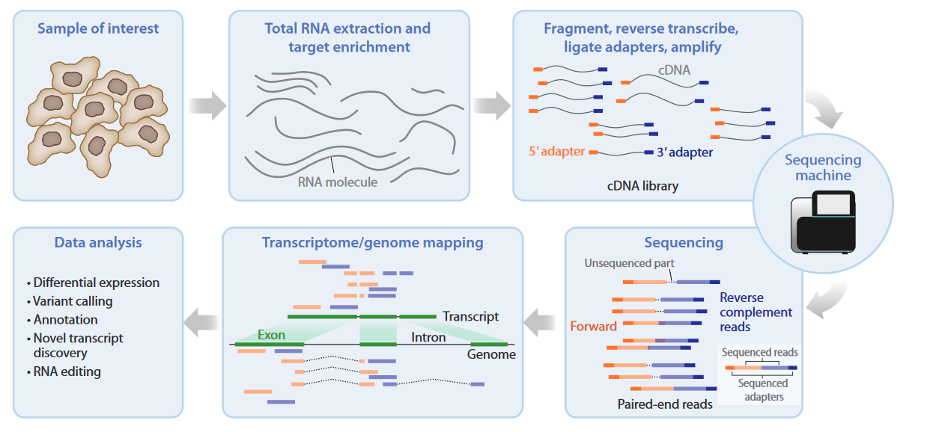
RNAseq - principle
Van den Berge et al, 2019. Annual Review of Biomedical Data Science

Slide 21
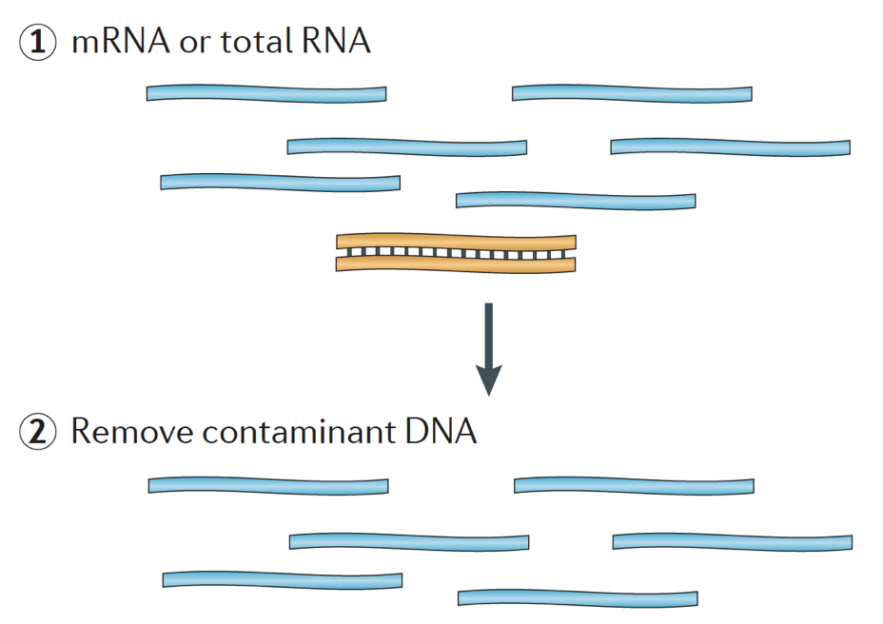
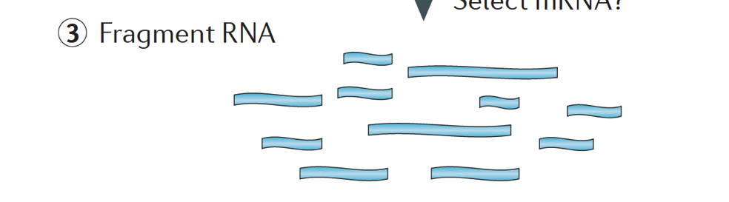
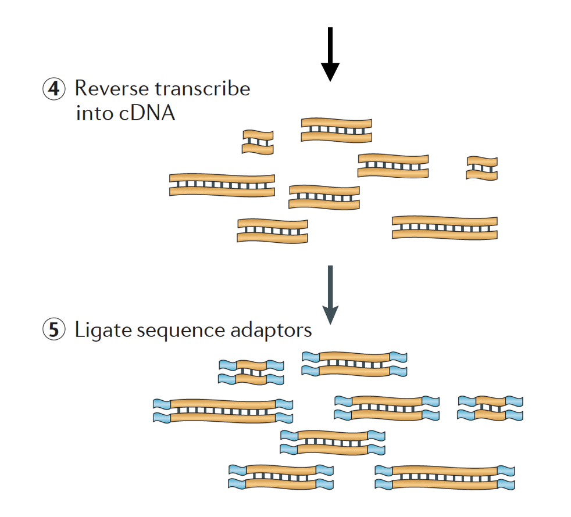
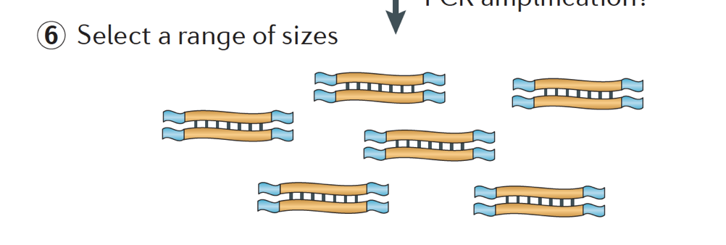
Library preparation
Remove rRNA
PCR amplification

Slide 22
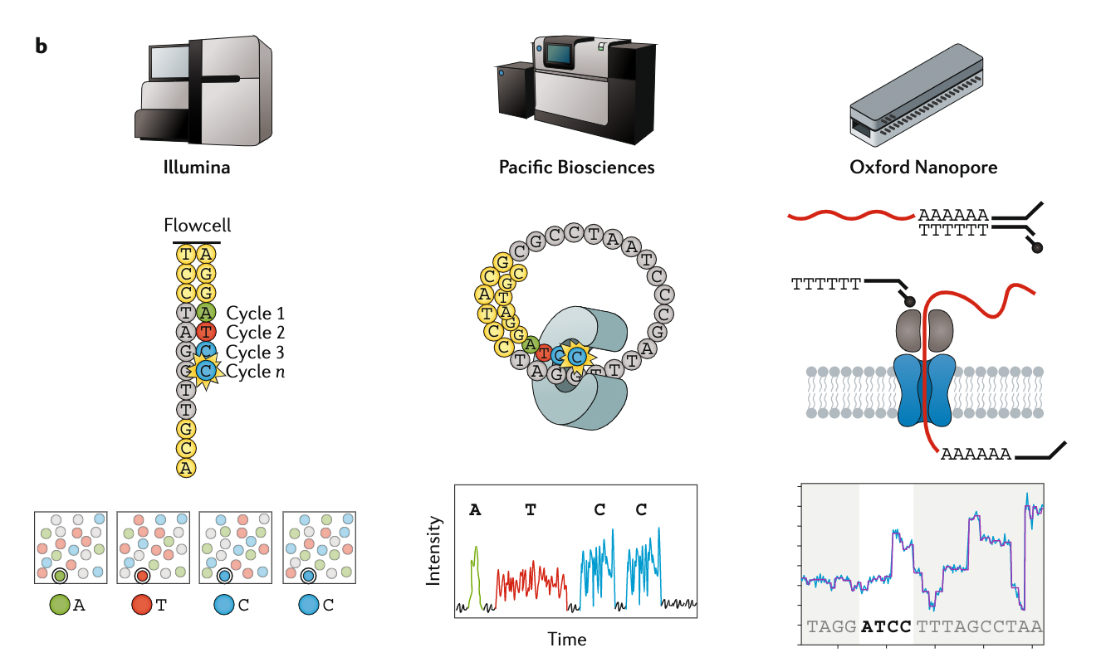
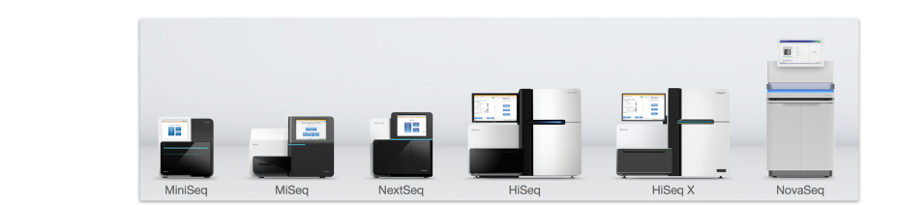
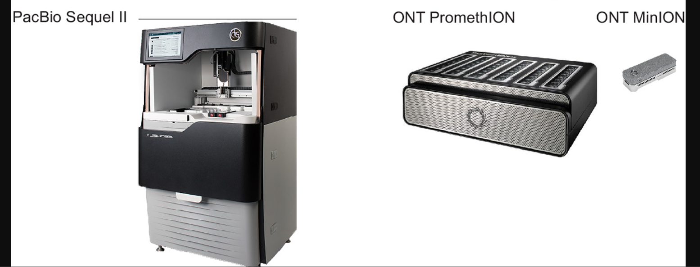
Sequencing platforms
Short read
Long read
Stark, Grzelak and Hadfield, 2019 Nature Reviews Genetics

Slide 23

Sequencing – Key concepts
Typical read length: 50-150bp.
Single-end (SE) vs. paired-end (PE)
SE: each (amplified) fragment is only sequenced once, from one direction.
PE: each (amplified) fragment is sequenced from both directions:
Sequencing depth
Total number of reads. Should be >20 million for standard gene-expression analysis without bells and whistles.
Phred (Q) score: each base assigned quality score
Probability (P) of base call being wrong. Q = -10 log10 P. E.g., Q = 10, P = 0.1 (poor); Q = 40, P = 0.0001 (good)

Slide 24
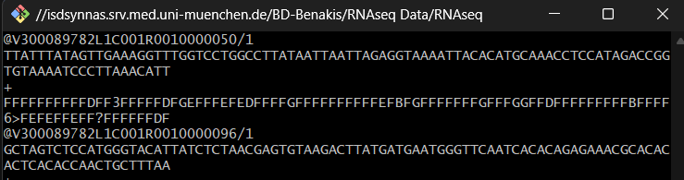
Understanding raw data
Line 1- header
Line 2: nucleotide sequence
Line 3: a (+) sign, separating sequence from quality score
Line 4: Base call quality scores, Phred33-encoded.

Slide 25
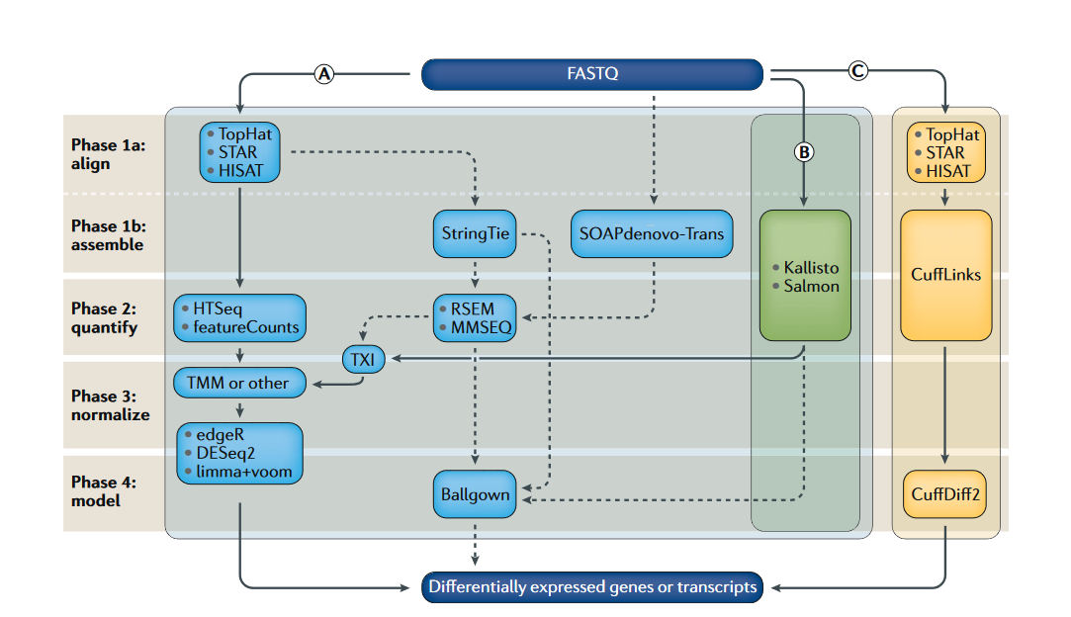
RNAseq data processing steps
QC
Stark, Grzelak and Hadfield, 2019 Nature Reviews Genetics

Slide 26
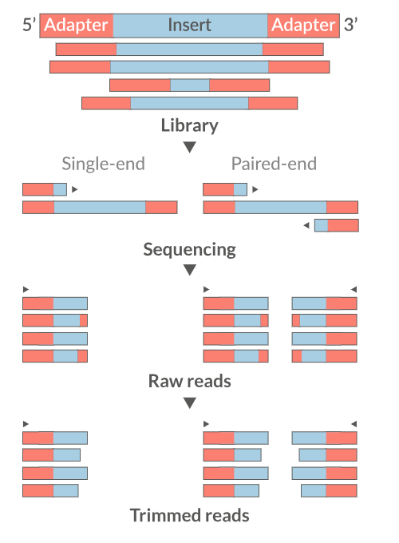
Quality control
Examine read quality
FastQC, MultiQC
Remove any adapter sequences , filter low quality reads
Trimmomatic, Cutadapt
Trimming and filtering poor quality bases/reads improves mapping rate

Slide 27
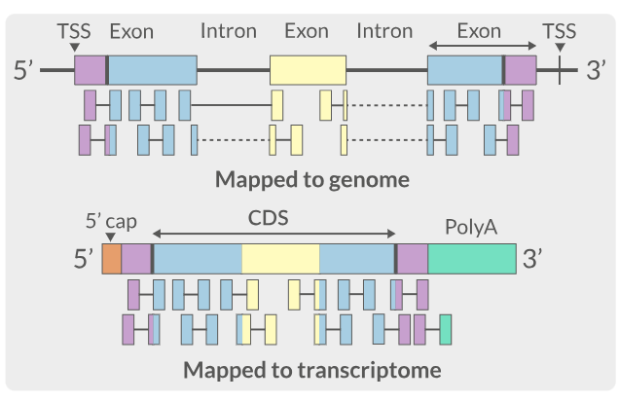
Mapping and quantification
Aligning trimmed and filtered reads to reference sequence
Genome (splice-aware) or transcriptome.
Quantifying number of hits to each gene/transcript
Genome
Transcriptome

Slide 28
RNAseq data analysis steps
Exploratory data analysis
Pathway/GO analysis
Stark, Grzelak and Hadfield, 2019 Nature Reviews Genetics

Slide 29
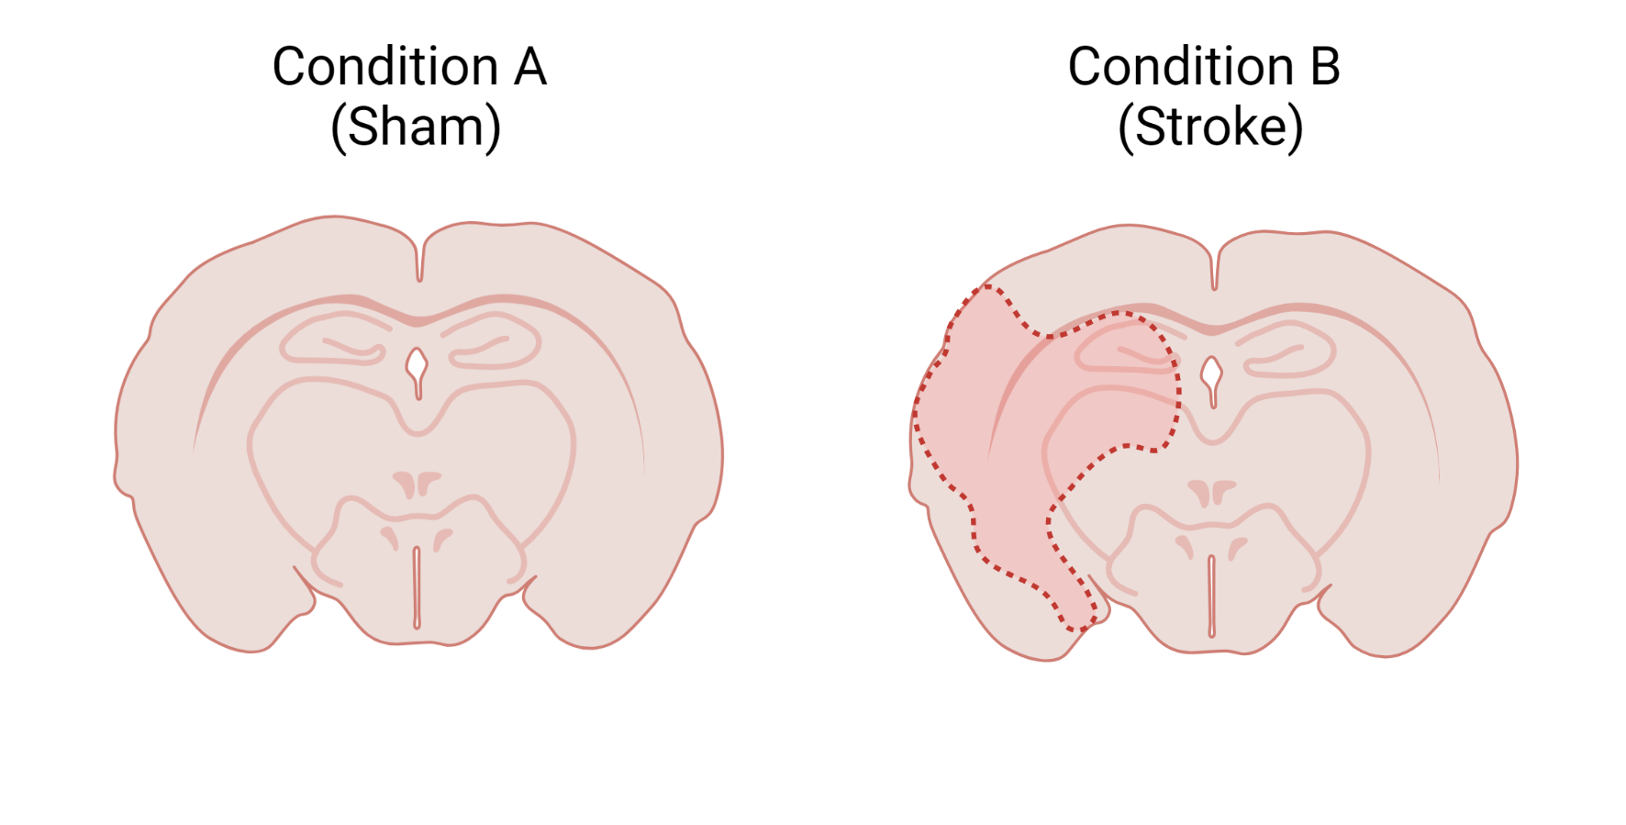
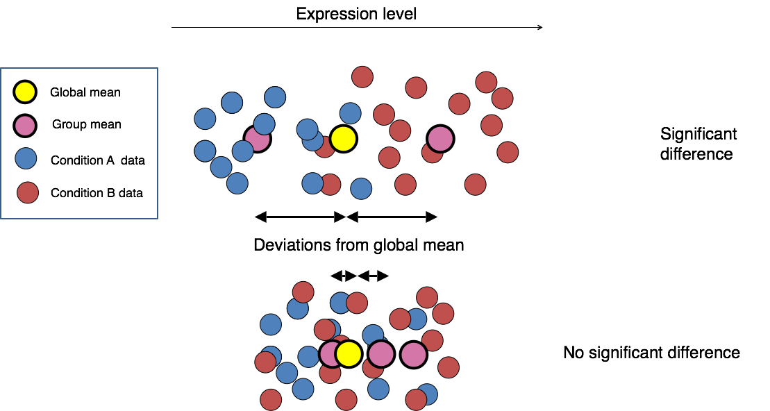
Differential expression
Which genes/transcripts are different between conditions?
Common tools include DESeq2, edgeR and limma/voom.

Slide 30
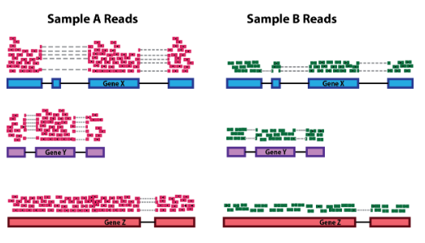
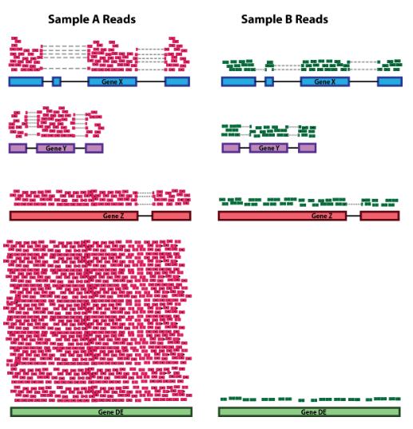
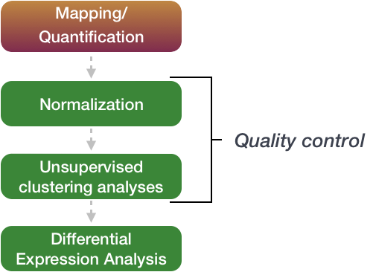
Differential expression - Normalization
Sequencing depth
Post-mapping –
Count matrix representing number of reads originating from each gene/transcript.
Raw counts not comparable between samples
Sequencing depth and RNA composition differ.
RNA composition

Slide 31
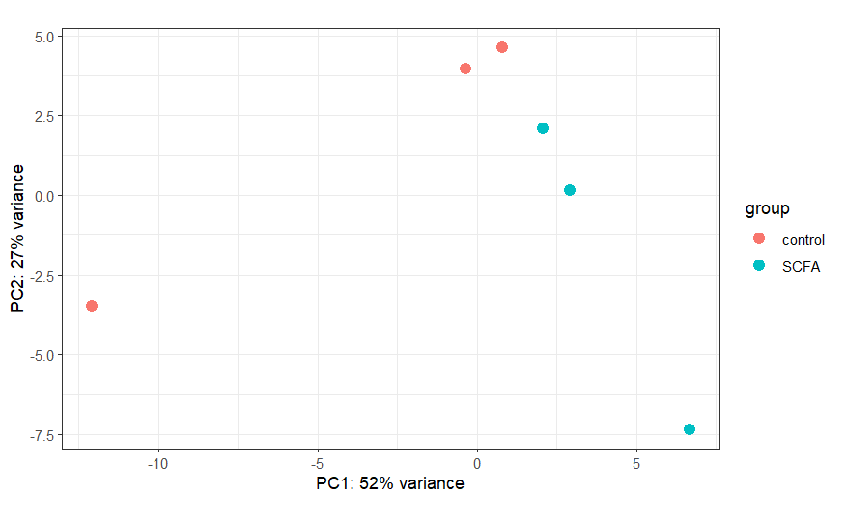
Differential expression - Unsupervised clustering
Important to understand how similar/different samples are.
Also useful to examine data for outliers/confounding variables
Principal component analysis (PCA) is a useful tool for this

Slide 32
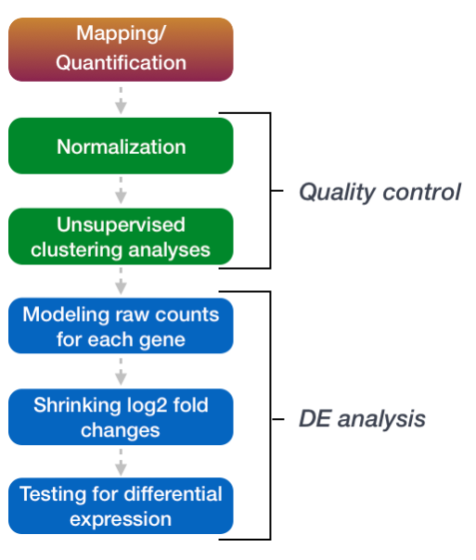
Differential expression – Identifying DEGs
Using DESeq2 as an example, identification of DEGs can be split into 3 steps:
Apply statistical model (in this case a negative binomial model) to the raw counts for each gene.
Estimate Log2FC and shrink imprecise estimates
Identify differentially expressed genes using hypothesis testing (in this case a Wald test, with the null hypothesis that there is no difference in expression between groups.

Slide 33
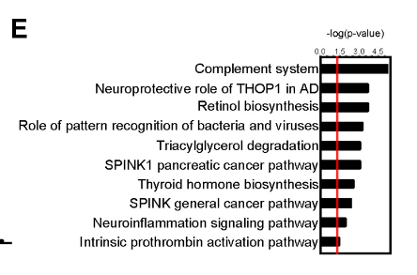
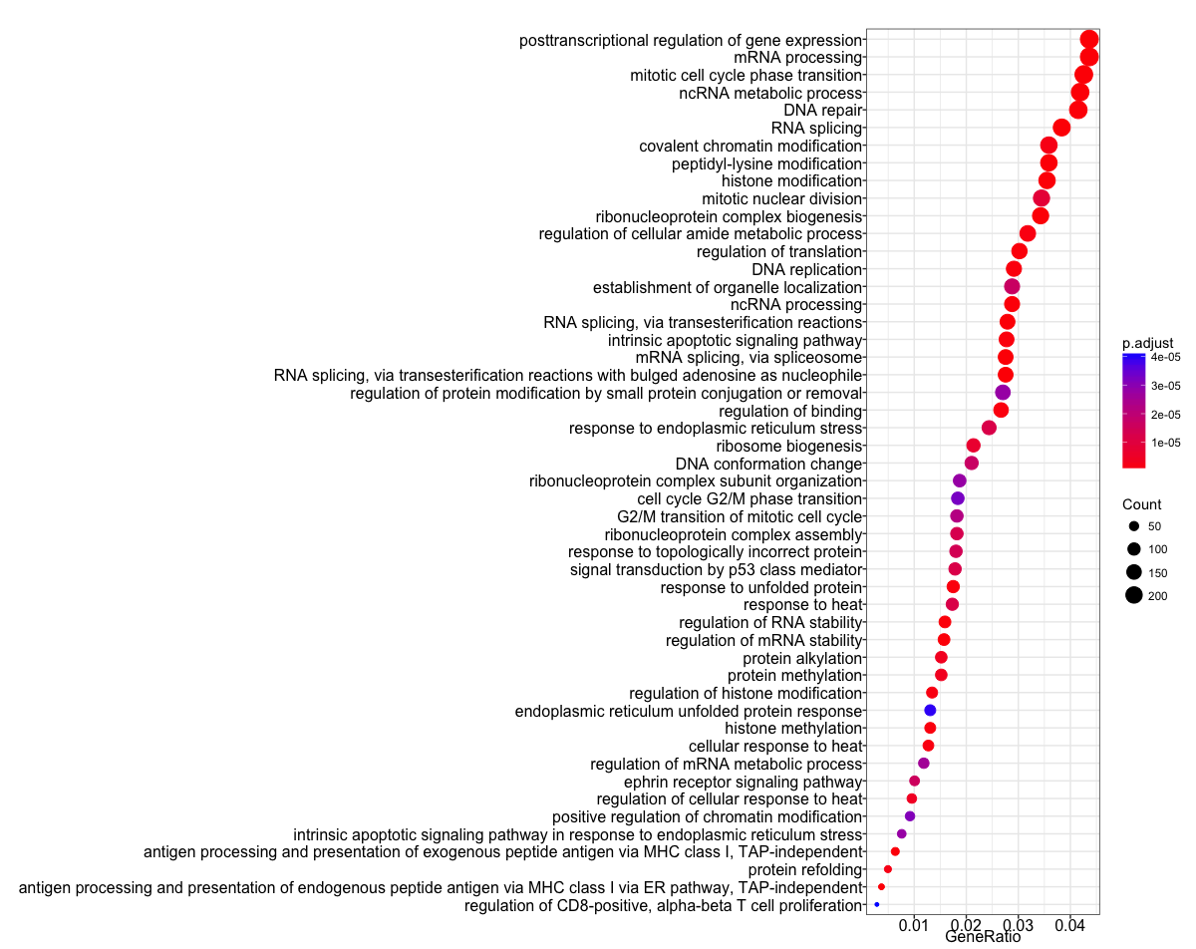
Gene ontology/Enrichment analysis
After identifying DEGs assigning pathways or functions to groups of genes can help make sense of results
Three main types: Over-representation analysis, functional-class scoring and pathway topology.
Common tools include R-based tools such as clusterProfiler and enrichR or online tools, like GSEA or DAVID.
Sadler et al, 2020, Journal of Neuroscience
Source: https://hbctraining.github.io/Training-modules/DGE-functional-analysis/lessons/02_functional_analysis.html

